Slide 1
6th February 2024
equality, diversity and inclusion Office
Information for PhD students
Muriel Besson
Head

Slide 2
Leaky pipeline

Slide 3
Mentoring program
For advanced female PhD students and postdocs
Cooperation between Western Switzerland universities
1:1 Mentoring with a professor from Switzerland or abroad
➔ Aim : Promote women researchers that aim at an academic career
Coordinator: Manuela Schicka
Information:
www.unifr.ch/f-mentoring/en/

Slide 4
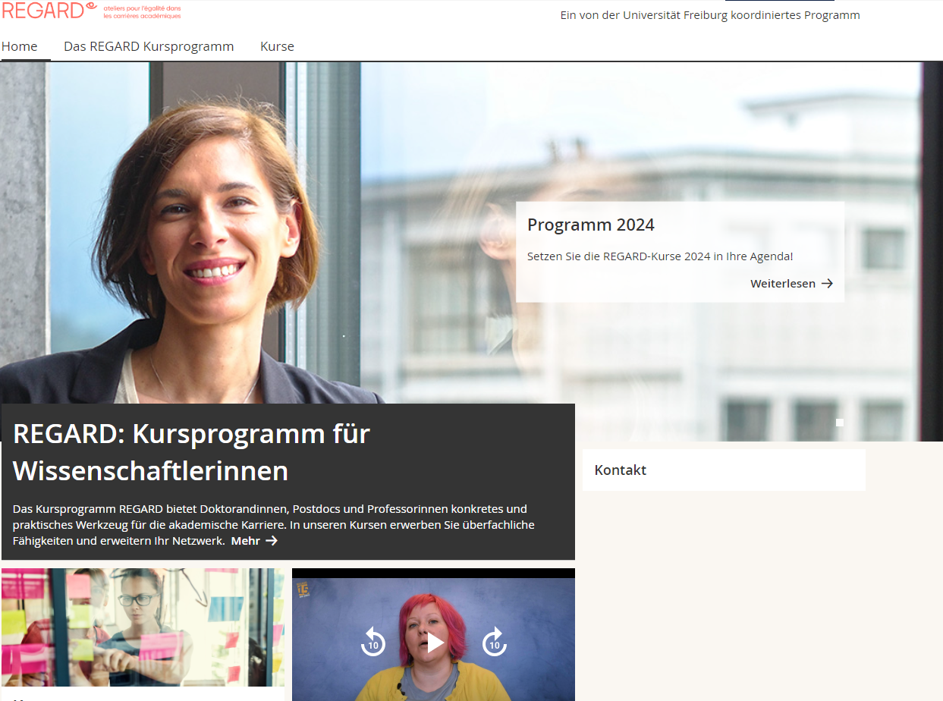
Further Education program
Cooperation between Western Switzerland universities and HES-SO
22 workshops
Topics :
Career planning Communication
Project management Personal development
Possibility to discuss and exchange with other female scientists
3 workshops for all
1 workshop only for men
Coordination: Manuela Schicka
Information and registration:
www.unifr.ch/regard/en/

Slide 5
Job – Private Life
Day-nursery of the university – 50 places Priority for children of students and staff of the university
Emergency care service Chaperon Rouge/Rotkäppchen (Care for ill children at home)
21 hours/year for free for university staff
Flexible work organisation and employment models
Family caregivers
Information:
www.unifr.ch/go/famille

Slide 6
Persons with disabilities
Consideration of specific needs
Students and staff with disabilities
Support in questions of access to buildings, infrastructure or application for disability adjustments
Contact : Nathalie Lambert – handicap@unifr.ch
Information
www.unifr.ch/go/handicap

Slide 7
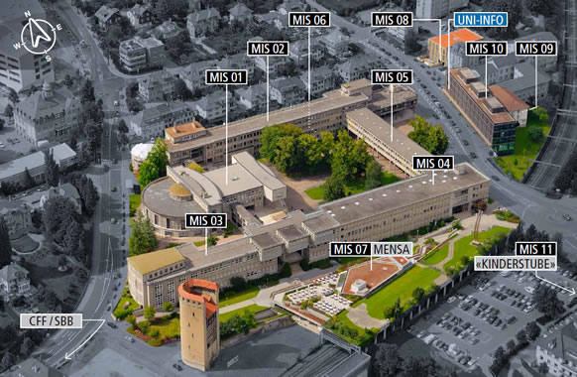
Information And Contact
Office 4064 MIS04
www.unifr.ch/egalite
egalite@unifr.ch
manuela.schicka@unifr.ch
muriel.besson@unifr.ch
S

