Slide 1
6th February 2024
  equality, diversity and inclusion Office
    Information for PhD students
      Muriel Besson
        Head

Slide 2
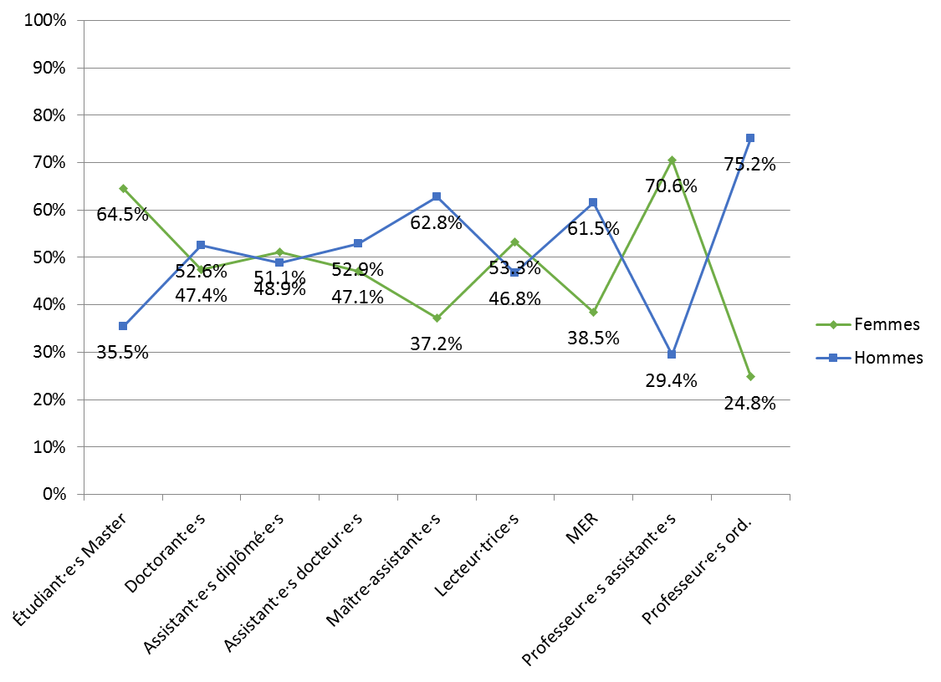
Leaky pipeline

Slide 3


Mentoring program
            For advanced female PhD students and postdocs
            Cooperation between Western Switzerland universities
            1:1 Mentoring with a professor from Switzerland or abroad
          ➔ Aim : Promote women researchers that aim at an academic career
          Coordinator: Manuela Schicka
Information:
    www.unifr.ch/f-mentoring/en/

Slide 4

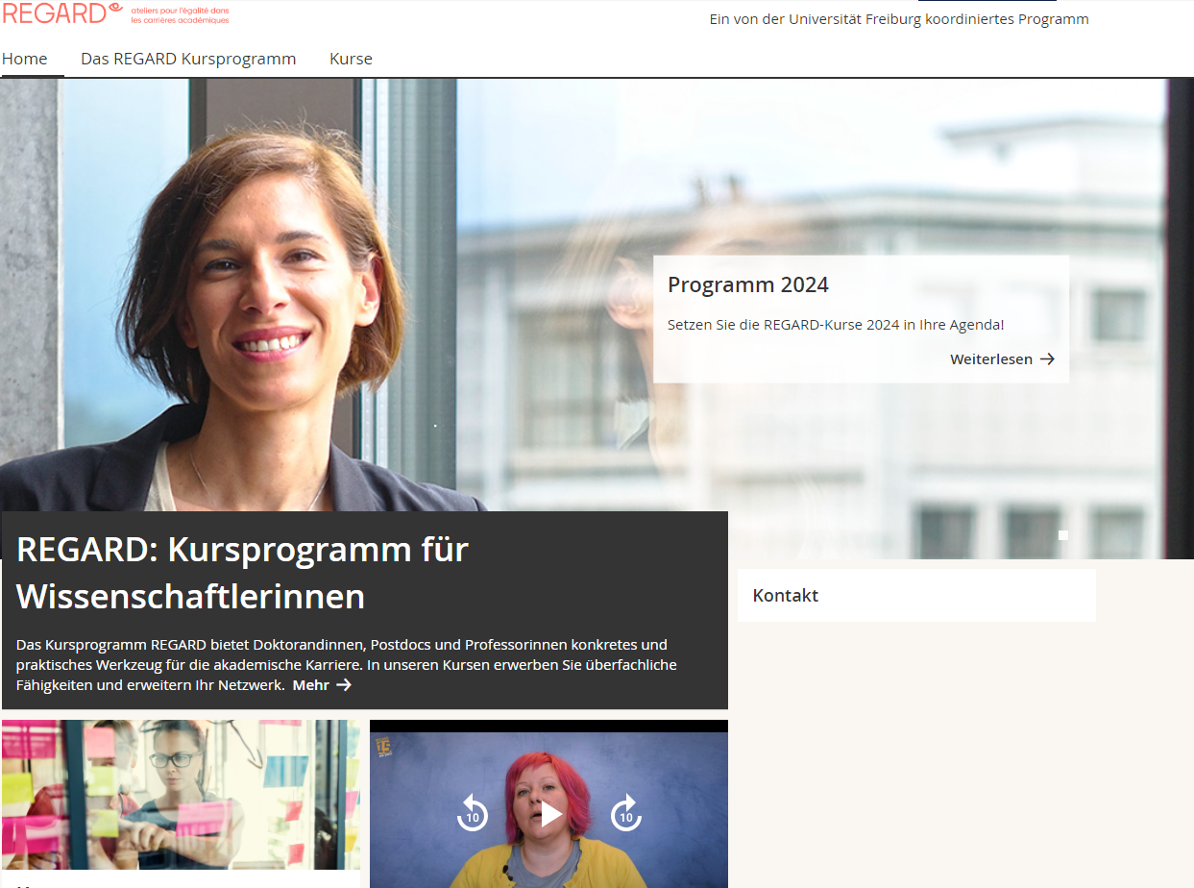
Further Education program
            Cooperation between Western Switzerland universities and HES-SO
            22 workshops
            Topics :
    Career planning Communication
    Project management Personal development
    Possibility to discuss and exchange with other female scientists
    3 workshops for all
    1 workshop only for men
    Coordination: Manuela Schicka
Information and registration:
    www.unifr.ch/regard/en/

Slide 5

Job – Private Life
Day-nursery of the university – 50 places
Priority for children of students and staff of the university
Emergency care service Chaperon Rouge/Rotkäppchen (Care for ill children at home)
21 hours/year for free for university staff
Flexible work organisation and
employment models
Family caregivers
Information:
www.unifr.ch/go/famille

Slide 6
Persons with disabilities
Consideration of specific needs
            Students and staff with disabilities
            Support in questions of access to buildings, infrastructure or application for disability adjustments
    Contact : Nathalie Lambert – handicap@unifr.ch
Information
    www.unifr.ch/go/handicap

Slide 7

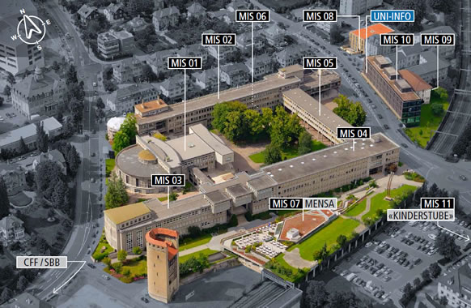
Information And Contact
    Office 4064 MIS04
    www.unifr.ch/egalite
    egalite@unifr.ch
    manuela.schicka@unifr.ch
    muriel.besson@unifr.ch
S

